Slide 1
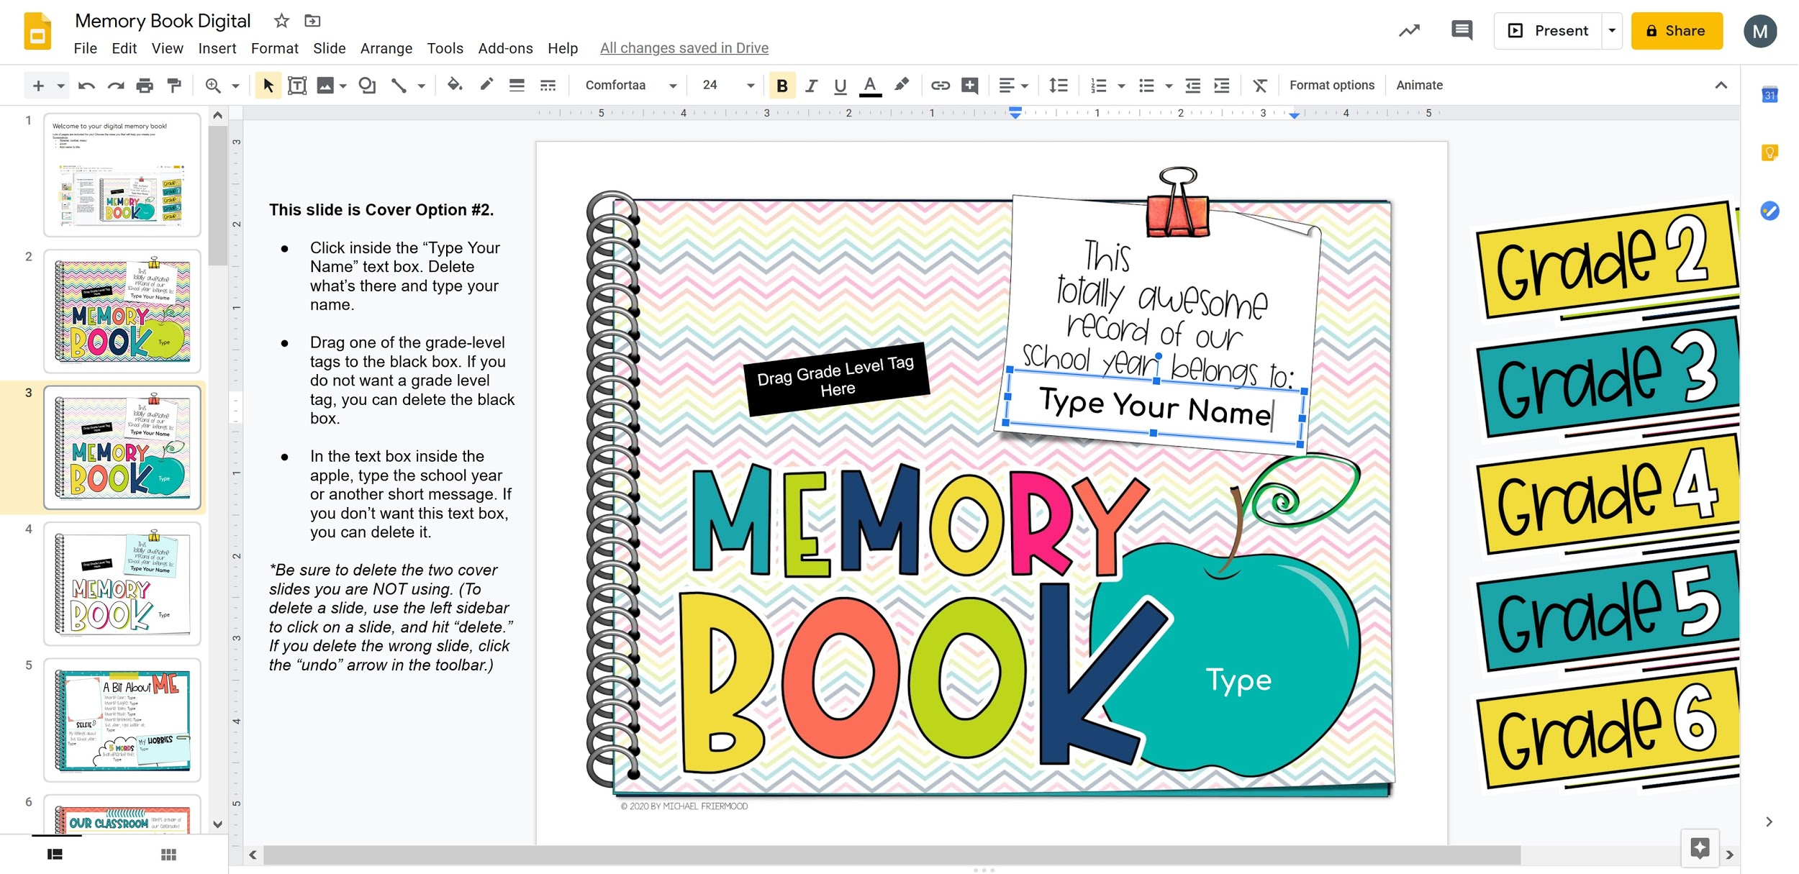
Welcome to your digital memory book!
Lots of pages are included for you! Choose the ones that will help you create the most memorable memory book of our school year! Before starting, add your name to the title of the file. Then read the following tips, and look at the diagram at the bottom.
Each slide has Directions & Tips the the left of what you see on the slide.
Each slide has text boxes set up for you to click in and type. Some slides also have moveable pieces to drag.
If you want to move slides into a different order, use the left sidebar to click and drag a slide to a different spot.
If you make a mistake, use the “undo” button in the toolbar (looks like a back-arrow).
To zoom in or out, use the “zoom” button in the toolbar (looks like a magnifying glass).
Tip!
After reading this Introduction Slide, you can drag it to the end of your memory book so it’s out of your way.
Title of file
Blue handles
(to pull an object into a
different size or angle.)
Menu bar
Toolbar
Sidebar
Directions & Tips
Text box
Moveable pieces (drag and drop)

Slide 2
This slide is Cover Option #1.
Click inside the “Type Your Name” text box. Delete what’s there and type your name.
Drag one of the grade-level tags to the black box. If you do not want a grade level tag, you can delete the black box.
In the text box inside the apple, type the school year or another short message. If you don’t want this text box, you can delete it.
*Be sure to delete the two cover slides you are NOT using. (To delete a slide, use the left sidebar to click on a slide, and hit “delete.” If you delete the wrong slide, click the “undo” arrow in the toolbar.)
Drag Grade Level Tag Here
Type Your Name
Type

Slide 3
This slide is Cover Option #2.
Click inside the “Type Your Name” text box. Delete what’s there and type your name.
Drag one of the grade-level tags to the black box. If you do not want a grade level tag, you can delete the black box.
In the text box inside the apple, type the school year or another short message. If you don’t want this text box, you can delete it.
*Be sure to delete the two cover slides you are NOT using. (To delete a slide, use the left sidebar to click on a slide, and hit “delete.” If you delete the wrong slide, click the “undo” arrow in the toolbar.)
Drag Grade Level Tag Here
Type Your Name
Type

Slide 4
This slide is Cover Option #3.
Click inside the “Type Your Name” text box. Delete what’s there and type your name.
Drag one of the grade-level tags to the black box. If you do not want a grade level tag, you can delete the black box.
In the text box in the lower right corner, type the school year or another short message. If you don’t want this text box, you can delete it.
*Be sure to delete the two cover slides you are NOT using. (To delete a slide, use the left sidebar to click on a slide, and hit “delete.” If you delete the wrong slide, click the “undo” arrow in the toolbar.)
Drag Grade Level Tag Here
Type Your Name
Type

Slide 5
“A Bit About Me”
Insert a photo of yourself for the “selfie” box. Here are two ways:
If you have a photo saved on your device: Go to “Insert Image” in the toolbar. Then “Upload from computer.” Find the photo.
If you want to take a selfie right now: Go to “Insert Image” in the toolbar. Then “Camera.” Take a picture of yourself with your device.
Make your photo fit into the box:
Crop: Use the cropping tool from the toolbar to cut off parts of the photo.
Shrink/enlarge: When the photo is selected, pull the blue “handles” in the corners of the photo to change the size.
Turn: To match the angle of the box, move the circular blue “handle” attached to the top of the image. This will rotate the image.
Complete the text boxes.
Type
Type
Type
Type
Type
Type
Type
Type
Type

Slide 6
“Our Classroom”
Create your classroom map with the shape tool.
Add shapes to represent the important parts of your classroom.
You don’t have to make the shapes look exactly like the real object. For example, maybe you use a triangle to represent the teacher chair.
Change a shape’s fill-color to help objects stand out from each other.
Add a mini-version of the shape to your “Key.”
You can hit “Ctrl + C” to copy a shape and “Ctrl + V” to paste another copy of it.
Don’t forget to drag the star and heart onto your map! (If the star and heart are “hiding” behind shapes you added, do this:
Select the start or heart. Go to “Arrange” in the Menu bar. Then “Order,” and “Bring to Front.”
= Type

Slide 7
“A Day in the Life”
Complete the text boxes.
Type
Type
Type
Type
Type
Type
Type

Slide 8
“Teacher Feature”
Complete the text boxes about your teacher.
Type
Type
Type
Type
Type
Type

Slide 9
“What A Class” Option #1
Use this slide if you have a photo of your class to add to the photo box. If not, you might want to use the next slide instead of this one.
Fill out all the text boxes.
*Be sure to delete the “What A Class” slide that you are NOT using.
Type
Type
Type
Type
Type
Type
Type
Type
Type

Slide 10
“What A Class” Option #2
Use this slide if you don’t have a photo of your class. If you do, you may want to use Option #1 instead.
Fill out all the text boxes.
*Be sure to delete the “What A Class” slide that you are NOT using.
Type
Type
Type
Type
Type
Type
Type
Type
Type

Slide 11
“Moments to Remember”
Add photos for each memory prompt. If you don’t have a photo to match the memory you want to write about, try inserting an image from the web that reminds you of the memory.
To do this, go to “Insert image” from the toolbar and select “search the web.”
Give a detailed summary of each memory.
Type
Type

Slide 12
“MORE Moments to Remember”
Add photos for each memory prompt. If you don’t have a photo to match the memory you want to write about, try inserting an image from the web that reminds you of the memory.
To do this, go to “Insert image” from the toolbar and select “search the web.”
Give a detailed summary of each memory.
Type
Type
Type

Slide 13
“Let’s Look at Some Books”
Type the titles of five of the best books you read this year.
Inside the image of the yellow book, type the title of your favorite book. (You could also try inserting an image of the book cover.)
Fill out the yellow sticky note about your favorite book.
Complete the rest of the text boxes.
Type
Type
Type
Type
Type
Type
Type
Type
Type
Type

Slide 14
“Talkin’ ‘bout Specials”
Complete the text boxes about your special area classes.
Type
Type
Type
Type
Type
Type
Type
Type
Type
Type
Type
Type
Type

Slide 15
“Lots of Learning”
Complete the text boxes about the different subject areas.
Type
Type
Type
Type
Type
Type
Type
Type
Type
Type
Type

Slide 16
“Recess Time!”
Complete the text boxes about recess.
If you want, insert a photo onto the blue sticky note in place of the text box.
Type
Type
Type
Type

Slide 17
“Lunch”
Complete the text boxes about lunch at school
Type
Type
Type
First, type
Type
Type
Type

Slide 18
“Special Events”
Complete the text boxes about special events.
Insert a photo into the middle area.
If you want to get fancy, try cropping the photo to match the circular shape of the border. (Select the photo, then click the dropdown menu next to “Crop” from the toolbar, then “shape,” then pick the circle shape.
Don’t forget to add a caption for the photo.
Type
Type
Type
Type

Slide 19
“Such Good Friends”
Add photos of a few of your friendships from this year. If you don’t have photos, try inserting images from the web that remind you of your friends. (For example, you might insert an image of something you and a friend like to do together.)
To do this, go to “Insert image” from the toolbar and select “search the web.”
Use the text boxes to describe the photos and the friendships.
Type
Type
Type

Slide 20
“Best Day Ever”
Pick your best school day of the year and type it above the dotted line.
Give all the details of that day in the text box below the dotted line.
Add a photo or image from the web to represent that day.
Add a caption to the speech bubble.
Type
Type
Type

Slide 21
“A Keepsake Forever”
Put a photo or image of your keepsake item IN the jar.
Complete the text box all about your keepsake item and why you chose it.
Type

Slide 22
“What’s Been Goin’ On”
Complete the text boxes about events that have happened this year in your community, your country, and around the world.
*Remember that you can change the order of the slides. If you think this slide fits in a different spot, use the left sidebar to click and drag the slide to a different location.
Type
Type
Type

Slide 23
“Pandemic”
Complete the text boxes about how the coronavirus pandemic affected your life.
*Remember that you can change the order of the slides. If you think this slide fits in a different spot, use the left sidebar to click and drag the slide to a different location.
Type
Type
Type

Slide 24
“At Home vs. At School”
Complete the text boxes about moving to distance learning.
A “pro” is a positive thing about it and a “con” is a negative thing about it.
*Remember that you can change the order of the slides. If you think this slide fits in a different spot, use the left sidebar to click and drag the slide to a different location.
Type
Type
Type
Type
Type
Type

Slide 25
“Build Your Own Page” #1
Change the title of the page to whatever you want.
Change the font and font size, too, if you want.
Drag in pieces from the right to help design your page.
Use the blue handles to change the size or the angle.
Add text boxes and/or images to complete the page.
Remember, if you need to move something in front of or behind something else:
Select the object, go to “Arrange” in the Menu bar, then “Order,” and click one of the options.
Build Your Own Page

Slide 26
“Build Your Own Page” #2
Change the title of the page to whatever you want.
Change the font and font size, too, if you want.
Drag in pieces from the right to help design your page.
Use the blue handles to change the size or the angle.
Add text boxes and/or images to complete the page.
Remember, if you need to move something in front of or behind something else:
Select the object, go to “Arrange” in the Menu bar, then “Order,” and click one of the options.
Build Your Own Page

